Slide 1
Cannonball People!

Slide 2
Created Values
Vx= 30 m/s
Vyi= 10 m/s
a= -9.81 m/s²

Slide 3
Solving for time
Vyf=-Vyi
Vyf=Vyi+at
(-10 m/s)= (10 m/s) + (-9.81m/s²) t
(-20m/s)/(-9.81m/s²)=t
2.0387s=t

Slide 4
Solving for Change in x
Vx= Δx/t
30 m/s = Δx/2.0387s
(30m/s)(2.0387s)=Δx
Δx= 61.161m

Slide 5
Solve for Change in y
ymax= Vyi (t/2) + ½ a (t/2)²
ymax=(10m/s)(2.0387s/2)+½(-9.81m/s²)(2.0387s/2)²
ymax=10.1935m+(-4.9999)
ymax= 5.1936m

Slide 6
Vertex of the Hoop
( ½ Δx, ymax)
(½ 61.161m, 5.1936)
Vertex= (30.5805,5.1936)

Slide 7
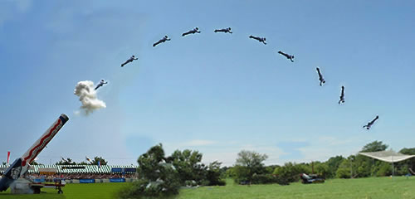
Diagram!
Top: 5.19m high
30.58m over
61.16m from canon

Slide 8
Summary
Vx= 30 m/s
Vyi= 10 m/s
a= -9.81 m/s²
2.0387s=t
Δx= 61.161m
ymax= 5.1936m
Vertex= (30.5805,5.1936)

